Slide 1
Online Course Application Using Python
Sattiraju Ravi Krishna,
Associate IT Consultant.

Slide 2
Agenda
Introduction
Business Requirement
Methodology
Overview
Functional Requirements / Tools Used
Outputs

Slide 3
Introduction
Online learning Course app is a great learning tool for students who do not have access to a physical classroom.
Online learning Course apps are designed to be engaging and enjoyable for students.
Knowledge augmentation, improved engagement, access to online study material, ease of communication, and, most significantly, remote access are all advantages of a learning app.

Slide 4
Business Requirements
Design an Online learning Course which can be worked on Desktop or laptop.
It is also allows users to take online classes in an efficient virtual environment.
The Course Should be Easily Available to Students and Mentors.
The Cost of the course should be Effective.
Should Have Customer Support and High Interface.
The System Failures Should be Less.

Slide 5
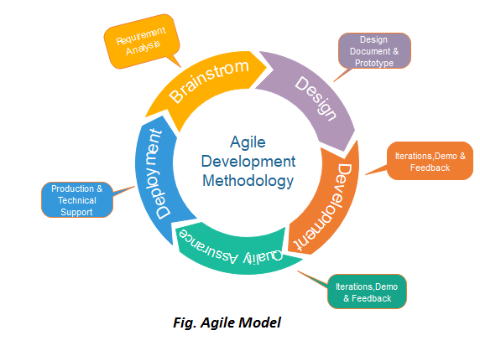
Methodology

Slide 6
Overview
Online courses teach students how to manage their time better since the student bears the responsibility of engaging with the course instead of simply showing up to class on an assigned day and time.
As a result, students not only gain knowledge from the coursework, but they also sharpen their time management skills.
And also there are some advantages are there using these online learning application are:
Flexibility. Many people turn to online learning for its flexibility.
Ability to Advance a Career.
Wider Range of Courses and Programs.

Slide 7
Functional Requirements / Tools Used
The Application should ask Basic details for registering into the app like Full name, Email id and Password.
The Users could able to add Courses into Cart Page.
The System Should Allow Authorized Users to make any payment.
Tools used In this system are:
PyCharm IDE for Code Development.
Git hub for Version Control and Storing.
Aws for Deployment in Cloud.
MySQL Database For Storing Data.

Slide 8




Tools Used Contd..

Slide 9
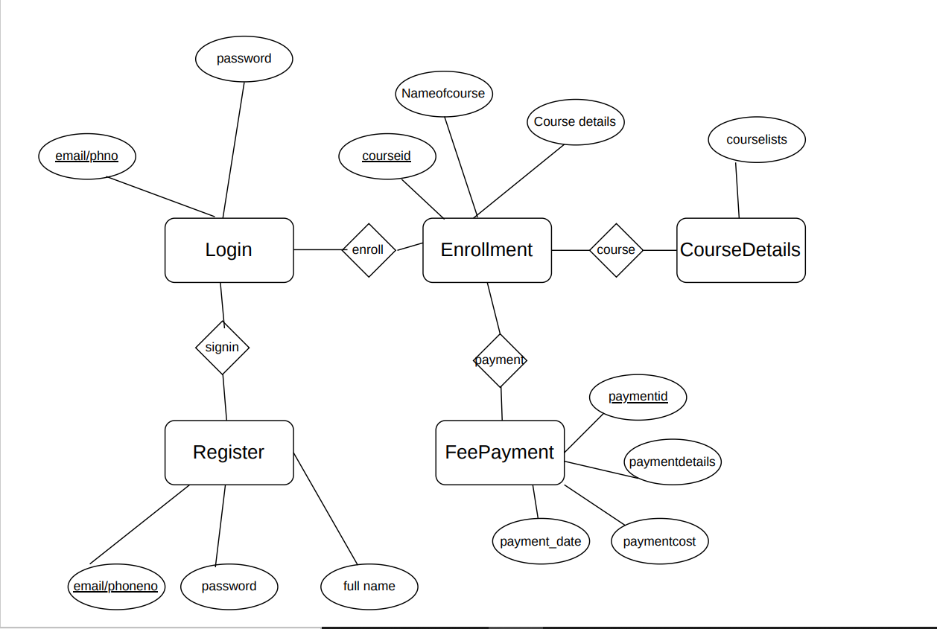
Outputs: ER Diagram

Slide 10
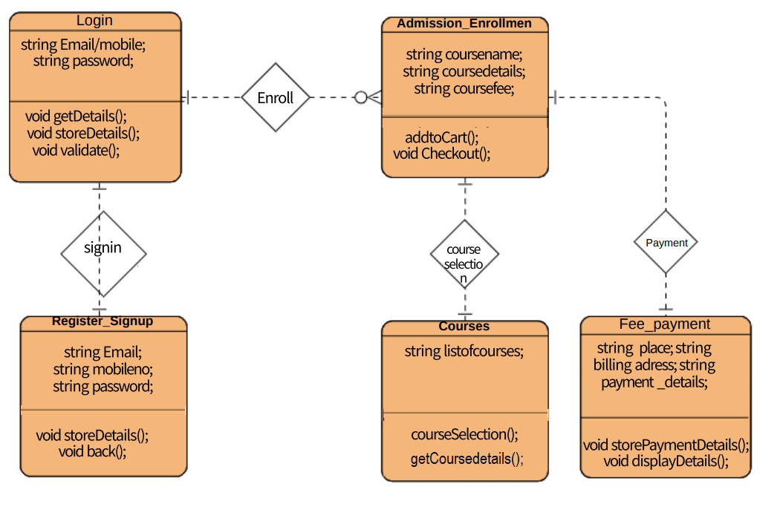

Slide 11
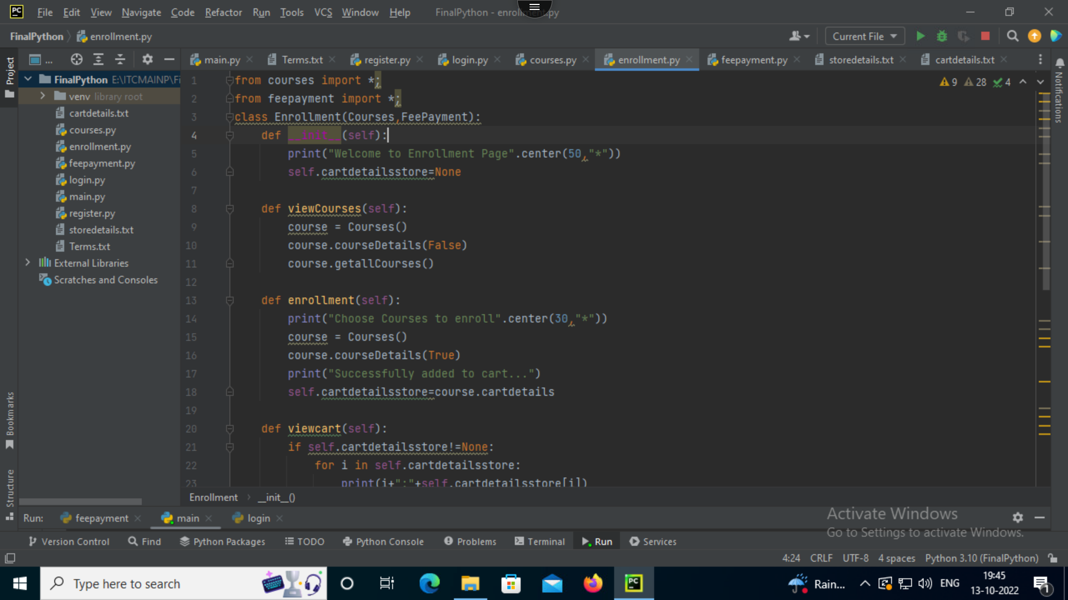

Slide 12
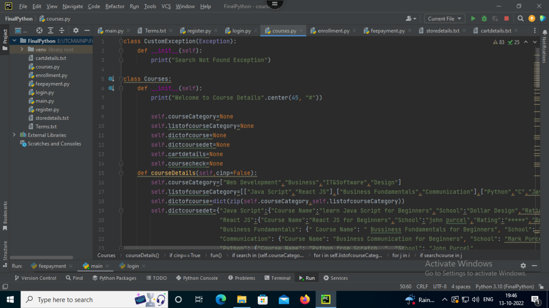

Slide 13
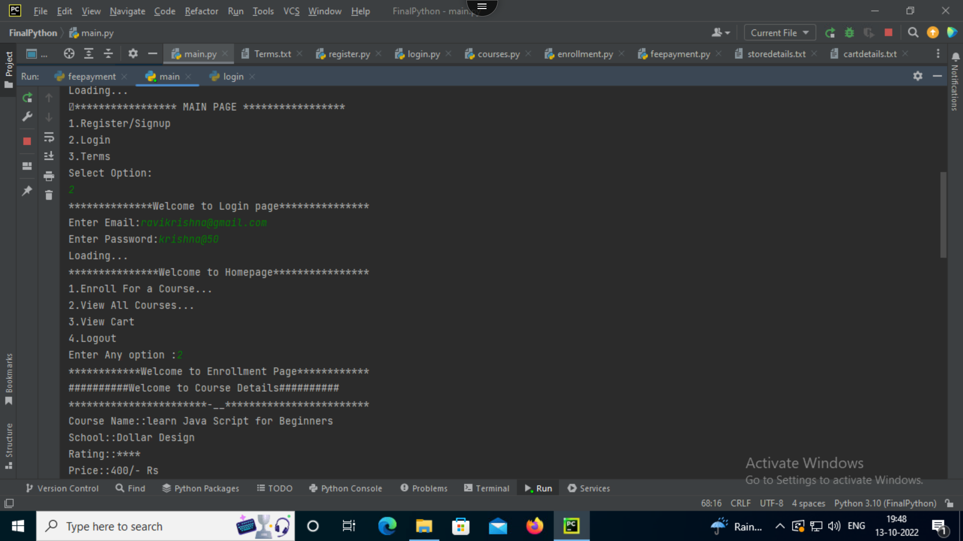

Slide 14
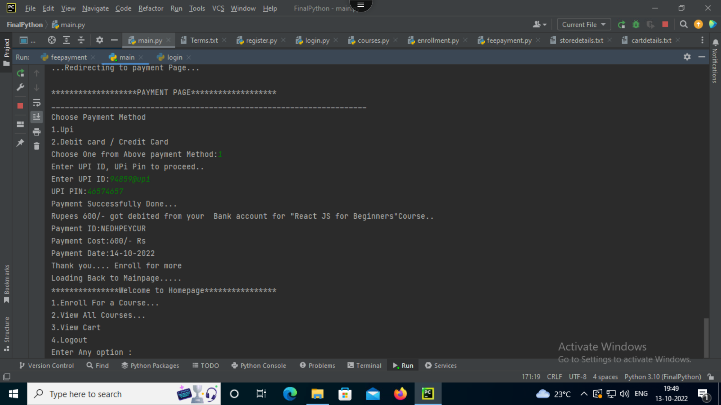

Slide 15
THANK YOU

Slide 16
QUESTIONS?

